Slide 1
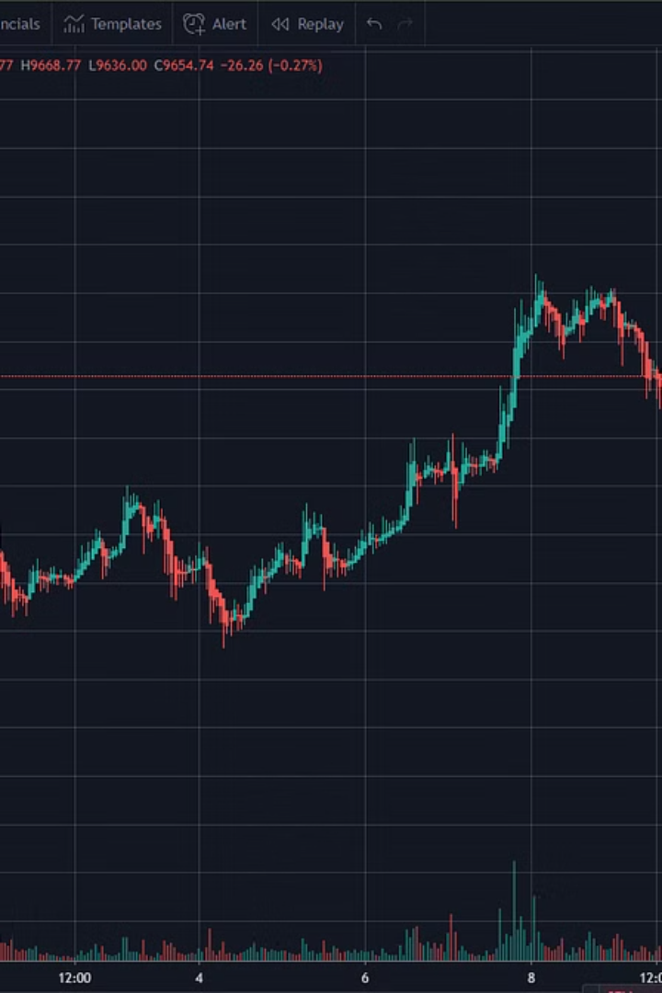
Real-Time Cryptocurrency Price Forecast Dashboard
This presentation will explore a novel dashboard designed to predict cryptocurrency prices in real-time using the power of Streamlit and time series models.
AA
by Anuj Agrawal

Slide 2
Problem Statement
Volatility
Decision Support
Cryptocurrency markets are known for their unpredictable price swings, making it difficult for investors to gauge future trends.
There's a need for reliable tools to provide accurate price predictions, empowering investors to make informed decisions amidst volatility.

Slide 3
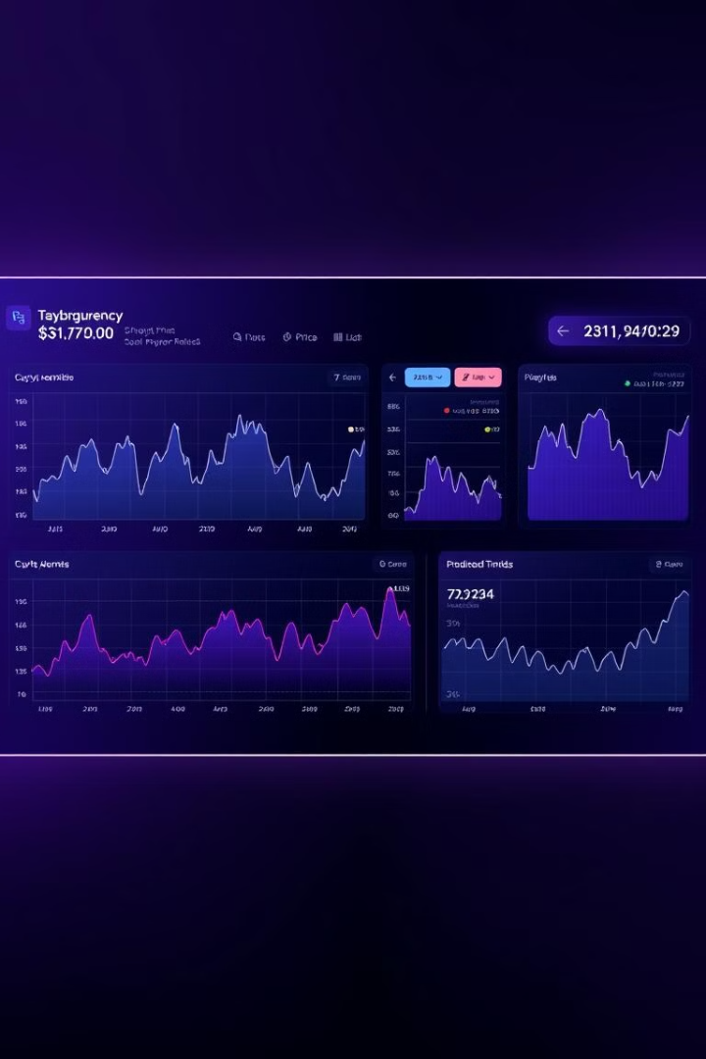
Proposed Solution
Real-Time Dashboard
ARIMA & SARIMA Models
The project presents a user-friendly dashboard built with Streamlit, delivering real-time cryptocurrency price predictions.
Utilizing ARIMA and SARIMA time series models, the dashboard provides accurate forecasts based on historical data.
Interactive Visualization
Users can select different cryptocurrencies, adjust forecast durations, and visualize historical and predicted data interactively.

Slide 4
System Flowchart
User Input
1
Users choose a cryptocurrency and the desired forecast duration.
2
Data Fetching
Historical data is retrieved from Yahoo Finance API.
Model Training
3
ARIMA and SARIMA models are trained on historical data.
4
Model Selection
The best model is chosen based on the Akaike Information Criterion (AIC).
Prediction Generation
5
Forecasted prices are generated and displayed alongside historical data.

Slide 5

Problems Faced During Development
1
Data Handling
2
Model Optimization
Handling inconsistent from the API was a significant challenge.
Optimizing the ARIMA and SARIMA models for efficient training required careful parameter tuning.
3
Volatility
4
Dashboard Design
Managing the inherent volatility and seasonality of cryptocurrency prices was a critical aspect.
Designing a user-friendly and interactive dashboard was essential to facilitate intuitive data exploration.

Slide 6





Future Scope
Advanced Models
Custom Date Ranges
Incorporating additional machine learning models, such as LSTM, for improved accuracy.
Support for more cryptocurrencies and customizable date ranges for forecasting.
Sentiment Analysis
Web Application
Integration with real-time market news sentiment analysis to enhance prediction accuracy.
Deploy the dashboard as a web application with cloud hosting for wider accessibility.

Slide 7
Thank you

